Slide 1
Bell Work: Mrs. Harris is on top of a scissors lift and needs to get down!!!!
1. What is m<B, m<C, & m<D if m<A=120?
2. Suppose you decrease m<A. What happens to m<B? (increase/decrease) AD? and the overall height of the scissors lift?
D
B
C
A

Slide 2
9.3 & 9.4 Properties of Rectangles, Rhombi, and Squares
Essential Question: What are the properties of rectangles, rhombi, and squares?

Slide 3
Rectangle- a quadrilateral with 4 right angles; a parallelogram (look at all the properties of a parallelogram); diagonals are congruent
R
E
A
T
C

Slide 4
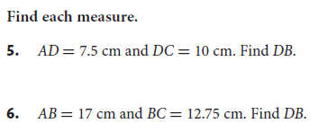
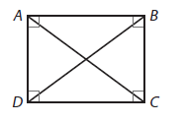
ABCD is a rectangle.
1.
2.

Slide 5
Rhombus (rhombi, rhombuses)- a quadrilateral with 4 congruent sides; a parallelogram; diagonals are perpendicular; each diagonal bisects a pair of opposite angles

Slide 7
Square- a quadrilateral with 4 sides congruent and 4 right angles; a parallelogram; a rectangle; a rhombus

Slide 8
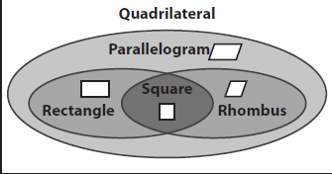
*Start In/Go Out- Always True
*Start Out/Go In- Sometimes True

Slide 9
Tear out pages 453-454
5-7; 9-13

Slide 10
Get your classwork and project out! I will pass around the stapler. Make sure your name is on it! p. 453
5. 48
6. 61.6
7. <1=29, <2=61, <3=90, <4=29, <5=90
9. AB=32.3 or 32 1/3
*10. 122 (we will go it)
11. <1=126, <2=27, <3=27, <4=126, <5=27
12. <1=55, <2=55, <3=55, <4=70, <5=55
A. Always
B. Sometimes
C. Always
D. Sometimes
E. Sometimes

Slide 11
Brain Teasers:
Examples: 4 W on a C 4 wheels on a car
13 O C 13 original colonies
1. S W and the 7 D 7. T no P L H
2. I H a D by M L K 8. I a S W A A
3. 2 P's in a P 9. H D D (T M R U T C)
4. 3 S to a T
5. 100 P in a D
6. 4 Q in a G

